Slide 1
Squared-Loss Function
Fitting Error Grows Quadratically

Slide 2
How about Linear-Loss ?
Linear-Loss Function
Fitting Error Grows Linearly

Slide 3
SVR uses the Loss Function below
ε-insensitive loss function
−ε
ε

Slide 4
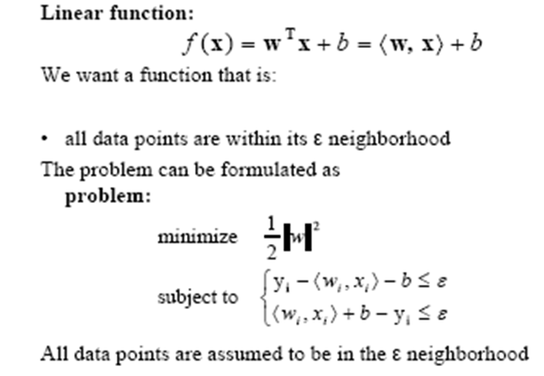
Support Vector Regression

Slide 5
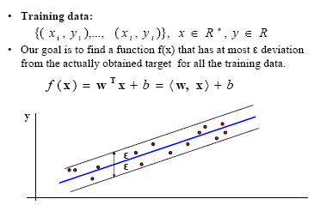
Support Vector Regression

Slide 6
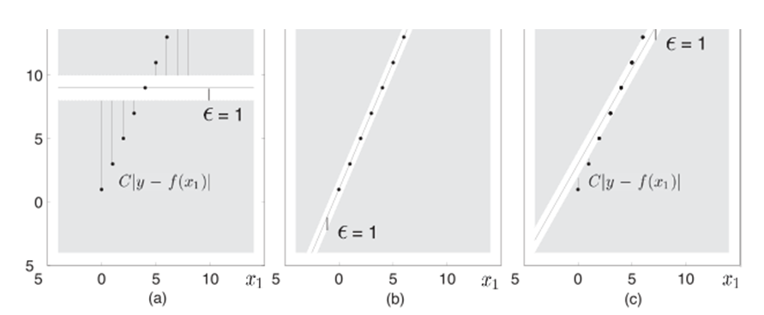

Slide 7
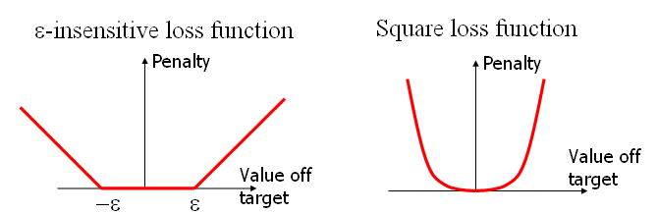

Slide 8
Linear ε- Insensitive Loss Regression
min
subject to
ε → decide Insensitive Zone
C → a trade-off between error and ||w||
εand C must be tuned simultaneously
Regression is more difficult than Classification?

Slide 9
Dual Formulation
Lagrangian function will help us to formulate the dual problem
ε: insensitive loss β_{i}* : Lagrange Multiplier
ξ_{i} : difference value for points above εband
ξ_{i}*: difference value for points below εband
Optimality Conditions

Slide 10
Dual Formulation(Cont’)
Dual Problem
Solving

Slide 11
Random forest Algorithm
Select ntree, the number of trees to grow, and mtry, a number no larger than number of variables.
For i = 1 to ntree:
Draw a bootstrap sample from the data. Call those not in the bootstrap sample the "out-of-bag" data.
Grow a "random" tree, where at each node, the best split is chosen among mtry randomly selected variables. The tree is grown to maximum size and not pruned back.
Use the tree to predict out-of-bag data.
In the end, use the predictions on out-of-bag data to form majority votes.
Prediction of test data is done by majority votes from predictions from the ensemble of trees.

